Slide 1
CS246: Basic IR (2)
Junghoo “John” Cho
UCLA

Slide 2
Bag of Words and Boolean Model
Two simplifying assumptions: Simplest “model” for information retrieval
Bag of words: ignore word ordering
Boolean: a document is either “relevant” to a query or not (0 or 1) depending on whether it contains the words in the query
Basic algorithm
For each $d∈C$:
If ($q⊆d):$return 1 else: return 0
Scalability issue

Slide 3
Inverted Index
Allows quick lookup of document ids with a particular word
Answer multi-word queries through intersection
Postings list
lexicon/dictionary V
3 | 8 | 10 | 13 | 16 | 20
PL(Stanford)
Stanford
1 | 2 | 3 | 9 | 16 | 18
PL(UCLA)
UCLA
MIT
4 | 5 | 8 | 10 | 13 | 19 | 20 | 22
PL(MIT)
…

Slide 4
Size of Inverted Index (1)
100M docs, 10KB/doc, 2000 words/doc (5B/word), 1000 unique words/doc, 4B/docid
Q: Document collection size?
Q: Inverted index size?
Q: How to estimate the vocabulary size of a corpus?
Heap’s Law: Vocabulary size = $k n^{b}$ with $30<k<100$ and $0.4<b<0.6$
$n$: total # of words
$k=50$ and $b=0.5$ are good rule of thumb

Slide 5
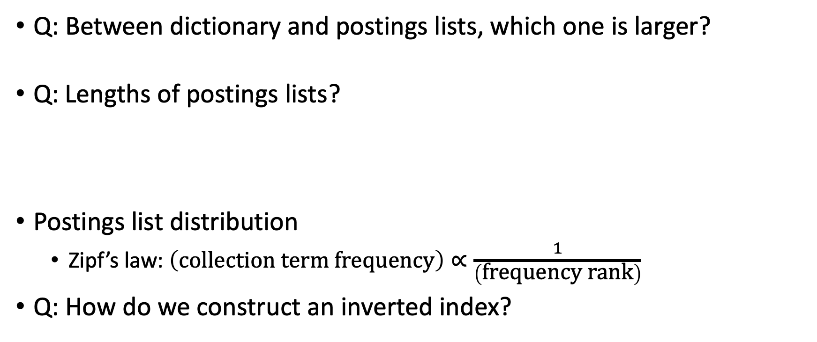
Size of Inverted Index (2)
Q: Between dictionary and postings lists, which one is larger?
Q: Lengths of postings lists?
Postings list distribution
Zipf’s law: $\left(\text{co}\text{llection} \text{term} \text{frequency}\right)∝\frac{1}{\left(\text{frequency} \text{rank}\right)}$
Q: How do we construct an inverted index?

Slide 6
Inverted Index Construction
C: all documents (corpus)
V: vocabulary (lexicon) of inverted index. Initially empty
PL(w): postings list of word w. Initially all empty
1: For each document $d∈C$:
2: $W=\text{extract}\text{−}\text{words}\text{(}d\text{)}$
3: For each $w∈W$:
4: If ($w∉V$): $V=V∪\{w\}$
5: $\text{Append} d.\text{id} \text{to} \text{PL}\left(w\right)$
Q: What if the index is larger than main memory?

Slide 7
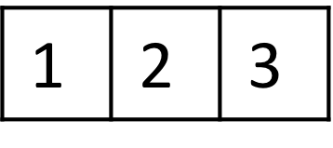
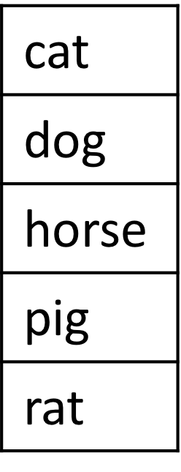
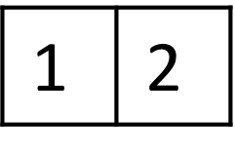
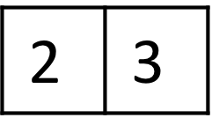
Inverted Index Construction
Disk-based merge-sort for large corpus
(dog, 1)
(cat, 1)
(pig, 1)
(cat, 2)
(horse, 2)
(dog, 2)
(cat, 3)
(rat, 3)
(horse, 3)
(cat, 1)
(cat, 2)
(cat, 3)
(dog, 1)
(dog, 2)
(horse, 2)
(horse, 3)
(pig, 1)
(rat, 3)
1
dog cat pig
tokenization
sort by token
2
cat horse dog
3
cat rat horse

Slide 8
Inverted Index: More Questions
Q: How can we look up a word from lexicon quickly?
Typically, 10K – 10M words in lexicon
Sequential scan?
A: Hash table, binary search, trie, … Preload into main memory
Q: How to deal with large postings list?
A: Postings lists stay in disk Compress using “gap encoding” (gap between successive docIDs)
Variable-byte encoding, $γ$-code, $δ$-code, …

Slide 9
Word Extraction
Q: How do we extract words from a document?
Basic idea
Split string into words at every “white space”
But:
Should “house” and “House” be the same word?
Should excited and excite be the same word?
What to do with punctuation marks?

Slide 10
Tokenization
Process of converting a stream of characters (document) into a sequence of “tokens”
Token: lexical unit corresponding to “basic concept”, often a word

Slide 11
Tokenization
Many “transformations” are possible during tokenization
Case folding: lower/uppercase all words
Punctuation removal
Stemming: map all inflected word forms to their “word stem”
excite, excites, excited, exciting, excitement, excitation ⟶ excit
Porter’s stemming algorithm
http://snowball.tartarus.org/algorithms/porter/stemmer.html
Stopword removal: remove most frequent words
Q: Why do we do this?
Phrase detection: map “New York” to a single token (not two)
Q: How can we do it?

Slide 12
Tokenization
What transformation to apply depends on what we want
But make sure to apply the same tokenization process both to the document and the query
Q: What if the user’s query has typo?

Slide 13
Spell Correction
Q: What is the user’s intention for the query “Britnie Spears”? How can the system figure out the “correct” spelling?
How can we formalize the spell correction problem?
Probabilistic approach
Given a string $w$, find the word $c$with the highest probability $P(c|w)$ to be the correct spelling of $w$
Q: How to estimate the probability?

Slide 14
Using Baye’s Rule
Bayes’ rule: $P\left(c | w\right)=P\left(w | c\right)P(c)/P(w)$
$P\left(c | w\right)=\frac{P\left(c∩w\right)}{P\left(w\right)}=\frac{P\left(c\right)P(w|c) }{P\left(w\right)}$
Baye’s rule allows us to “invert” original conditional probability
Sometimes, inverse conditional probability is easier to estimate than the original probability
Q: What are the above probabilities and how can we estimate them?
Rule of thumb:
75% misspells are within edit distance 1.
98% are within edit distance 2.
c
w

Slide 15
Where We Are
IR problem as a decision problem
Given $q$, $∀d∈C,$compute$R^{′}\left(q\right)=\left\{ d∈C\right| f\left(d,q\right)=1\}$, where $f\left(d,q\right)→\{0,1\}$ is a binary classifier
Two gross simplifications
Bag of words, boolean model
Tokenization and spell correction to map documents and queries to canonical tokens
Data structures and algorithms for efficient retrieval under the boolean model

Slide 16
Is Boolean Model Effective?
Clearly not what users truly mean by a query
Does this overly simplistic model really work?
But quite useful!
Filters out most “irrelevant” documents
Assuming users can provide best terms for filtering
Ultimately, effectiveness of any IR model should be evaluated by benchmark dataset
Inherent limitation for a large corpus
Millions of “relevant” documents are returned!!!
No help by the model to “prioritize” which one to look at first
Every returned document is relevant!

Slide 17
Challenge: Too Many Matching Documents!
Solution 1: Allow more “complex” boolean queries
((UCLA OR Stanford) AND (NOT USC)) AND application
Does it work? What are pros and cons?
Solution 2: “Rank” documents by their “relevance”

Slide 18
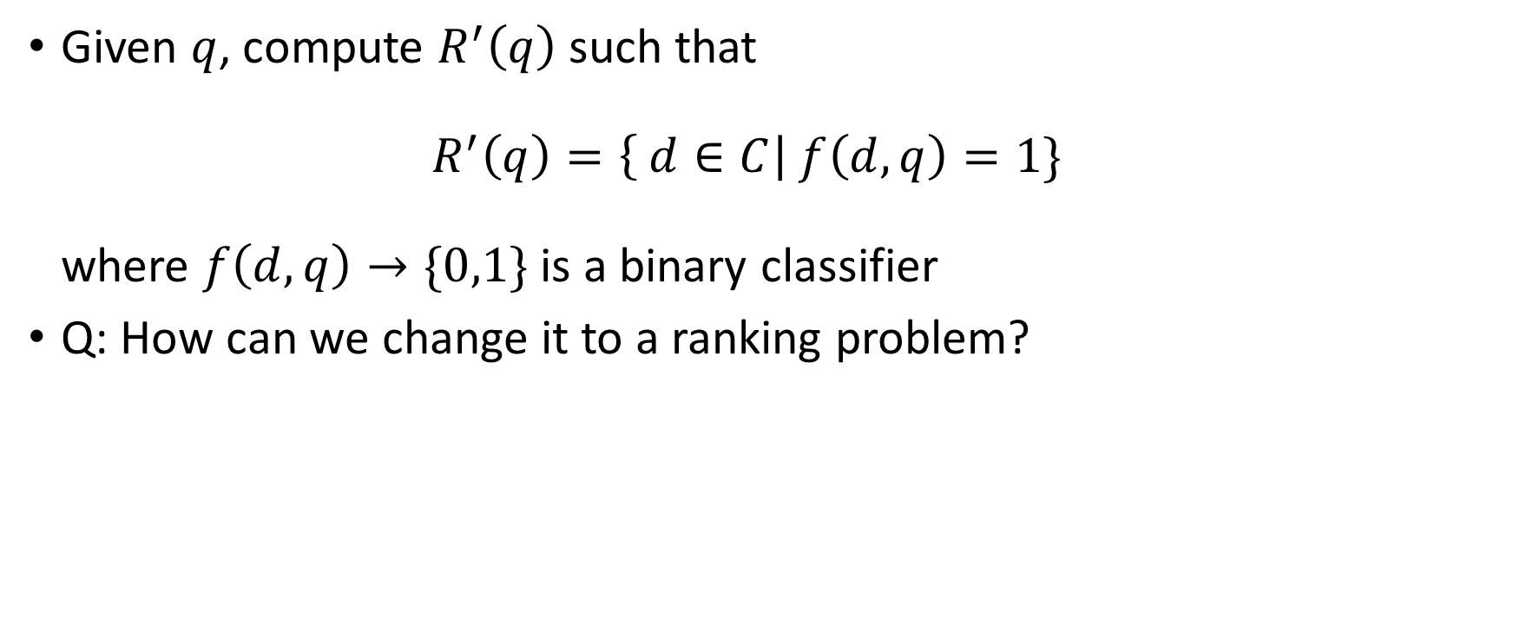
IR as a Decision Problem
Given $q$, compute $R^{′}\left(q\right)$ such that $R^{′}\left(q\right)=\left\{ d∈C\right| f\left(d,q\right)=1\}$ where $f\left(d,q\right)→\{0,1\}$ is a binary classifier
Q: How can we change it to a ranking problem?

Slide 19
IR as a Ranking Problem
Given q, $∀d∈C$, compute ranking function $f\left(d,q\right)→ ℛ$ such that if $f\left(d_{1},q\right)>f\left(d_{2},q\right)$, then $d_{1}$ is more relevant than $d_{2}$
Q: How can we compute the scoring function $f\left(d,q\right)$?

Slide 20
IR Models for Ranking Problem
Many different models exist for computing $f\left(d,q\right)$
Similarity-based model: $f\left(d,q\right)=“similarity”(d, q)$
How do we compute “similarity”?
Vector-space model (VSM)
Probabilistic model: $f\left(d,q\right)=Pr⁡\{d∈R\left(q\right)\}$
How do we compute “probability”?
Classic probabilistic model, language model, …
Interestingly, different models often lead to very similar ranking functions
TFIDF (VSM) and BM25 (probabilistic) are two most popular ranking functions

